Slide 1

Introduction To
&
{JSON}
Prepared by : Aep Hidayatuloh
Email : aephidayatuloh.mail@gmail.com
GitHub : https://github.com/aephidayatuloh

Slide 2
Workshop {Pre-requisite}

Slide 3
{Pre-requisite}
Internet Connection
Software Installed:
R program (https://cran.r-project.org/)
RStudio (https://www.rstudio.com/products/rstudio/download/)
Materials:
Download at https://github.com/aephidayatuloh/r_json_basic
R Packages:
jsonlite : install.packages("jsonlite")
dplyr : install.packages("dplyr")
ggplot2 : install.packages("ggplot2")
tidyr : install.packages("tidyr")
Use install.packages(c("jsonlite", "dplyr", "ggplot2", "tidyr")) to install all those packages or simply install.packages(c("tidyverse", "jsonlite")) to install jsonlite, dplyr, ggplot2, tidyr and other useful packages.

Slide 4








{Import Data Into R}
etc.

Slide 5
{Import Data Into R}
# Import data from ~.txt file
x1 <- read.table("path/to/file.txt", header = TRUE)
# Import data from ~.csv file
x2 <- read.csv("path/to/file.csv", header = TRUE)

Slide 6
{Objects In R}
Vector: 1D same type
Matrix: 2D same type
Array: matrix with > 2D
Dataframe: mostly 2D and can be different type for each column
List:
Different R object

Slide 7
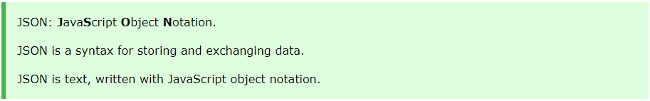


{JSON}

Slide 8
{JSON} – Syntax Rules
JSON syntax is derived from JavaScript object notation syntax:
Data is in name/value pairs
Data is separated by commas
Curly braces hold objects, {objects} → value of data
Square brackets hold arrays [arrays] → List
{"name":"John"}
{"key":"value"}

Slide 9
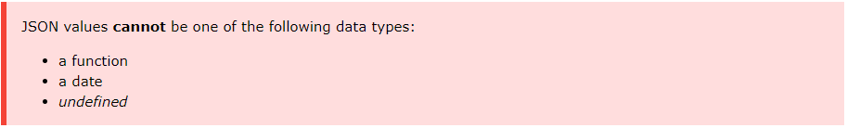
{JSON} – Data Types
In JSON, values must be one of the following data types:
"string"
number
object (JSON object)
array
boolean
null

Slide 10
{JSON} – Data Types
String
{ "name":"John" }
Numeric
{ "age":38 }
JSON Object
{ "employee":{ "name":"John", "age":30, "city":"New York" } }
Array
{
"employees":[ "John", "Anna", "Peter" ]
}
Boolean
{ "male":true }
Null
{ "midname":null }
How about Date values?
Date as string → convert in R as date

Slide 11
Simplest {Format}

Slide 12
{JSON} – Format
Format 1:
{
"var1":[1, 2],
"var2":["value1", "value2"],
"var3":[623.3, 515.2]
}

Slide 13
{JSON} – Format
Format 1:
{
"ID":[1, 2, 3, 4, 5],
"Name":["Rick", "Dan", "Michelle", "Ryan", "Gary"],
"Salary":[623.3, 515.2, 611, 729, 843.25],
"StartDate":["1/1/2012", "9/23/2013", "11/15/2014", "5/11/2014", "3/27/2015"],
"Dept":["IT", "Operations", "IT", "HR", "Finance"]
}

Slide 14
{JSON} – Format
Format 2:
[
[1, "value1", 623.3],
[2, "value2", 515.2]
]

Slide 15
{JSON} – Format
Format 2:
[
[1, "Rick", 623.3, "1/1/2012", "IT"],
[2, "Dan", 515.2, "9/23/2013", "Operations"],
[3, "Michelle", 611, "11/15/2014", "IT"],
[4, "Ryan", 729, "5/11/2014", "HR"],
[5, "Gary", 843.25, "3/27/2015", "Finance"]
]

Slide 16
{JSON} – Format
Format 3:
[
{
"var1":1,
"var2":"value1",
"var3":623.3
},
{
"var1":2,
"var2":"value2",
"var3":515.2
}
]

Slide 17
{JSON} – Format
Format 3:
#row-1
[
{
"ID":1,
"Name":"Rick",
"Salary":623.3,
"StartDate":"1/1/2012",
"Dept":"IT"
},
…
#row-2
…
{
"ID":2,
"Name":"Dan",
"Salary":515.2,
"StartDate":"9/23/2013",
"Dept":"Operations"
},
…
#row-3
…
{
"ID":3,
"Name":"Michelle",
"Salary":611,
"StartDate":"11/15/2014",
"Dept":"IT"
},
…
#row-4
…
{
"ID":4,
"Name":"Ryan",
"Salary":611,
"StartDate":"5/11/2014",
"Dept":"HR"
},
…
]

Slide 18
Let’s Get {Dirty}!

Slide 19
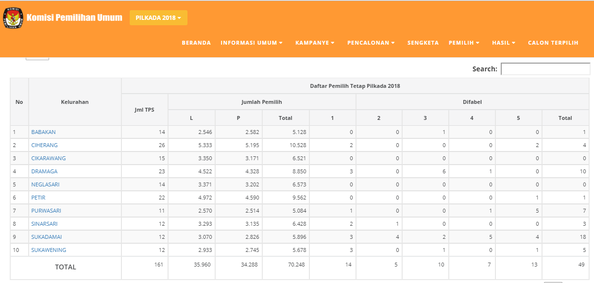
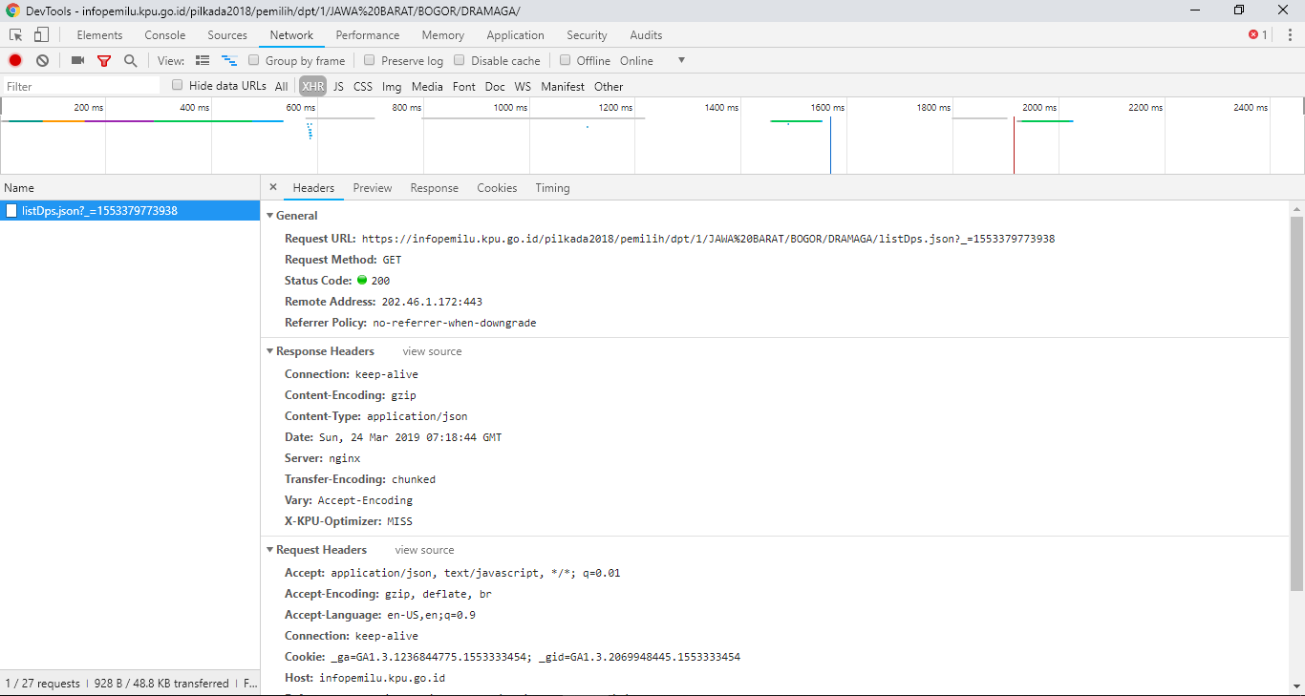
{JSON} – From Web
Read JSON data from website: https://infopemilu.kpu.go.id/

Slide 20
Next Level! {Nested JSON}

Slide 21
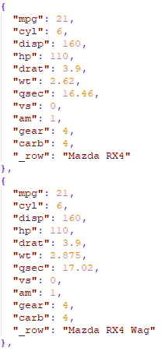

{JSON} – Simple Format

Slide 22
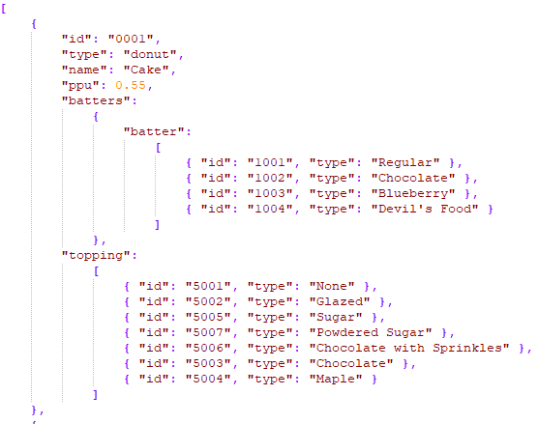

{JSON} – Nested

Slide 23
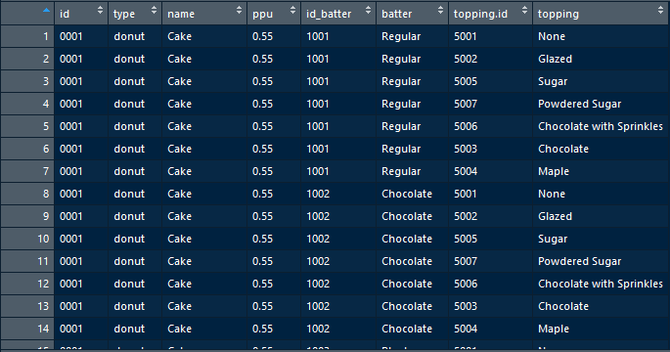
{JSON} – Tidy Data

